Slide 1



Predicting Salaries for Data Professionals
Accurately predicting salaries for data professionals is crucial for both job seekers and employers. For job seekers, understanding the expected salary range can help them make informed decisions about their career and compensation. For employers, setting competitive salaries is essential to attract and retain top talent. This presentation explores a comprehensive analysis of a dataset containing information about data professionals, with the goal of developing a reliable model to predict their salaries.

Slide 2

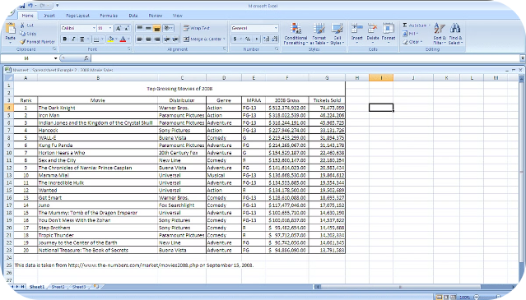
Dataset Overview
The dataset used in this analysis includes a variety of information about data professionals, such as their first and last names, sex, date of joining, current date, designation, age, salary, unit, leaves used, leaves remaining, ratings, and past experience. This wide range of variables provides a rich dataset for exploring the factors that may influence the salaries of data professionals.

Slide 3

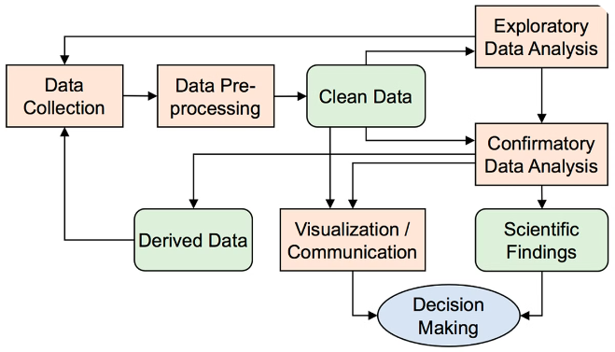
Exploratory Data Analysis
1
Purpose of EDA
The purpose of the exploratory data analysis (EDA) is to summarize the key characteristics of the dataset, uncover patterns and relationships, and identify any issues, such as outliers or missing values, that may need to be addressed before model development.
2
Insights from EDA
The EDA will provide a deep understanding of the data, including the shape, data types, and summary statistics of the various features. This will help inform the subsequent data preprocessing steps and guide the selection of appropriate modeling techniques.
3
Identifying Patterns
The EDA will also aim to identify any patterns or relationships between the various features and the target variable, salary. This will lay the foundation for the later stages of the analysis, including feature selection and model development.

Slide 4
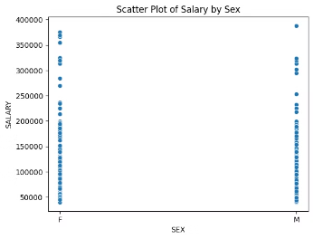
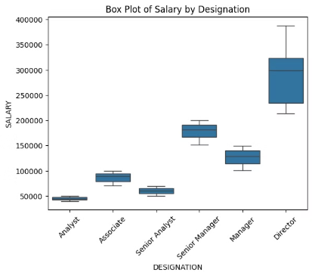
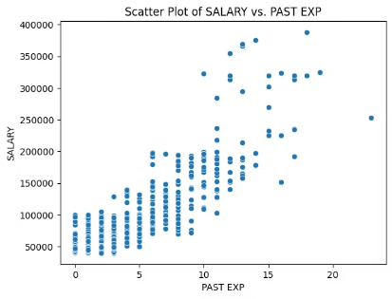
Bivariate Analysis
Salary vs. Sex
Salary vs. Designation
Salary vs. Age and Experience
The analysis will examine the relationship between an employee's sex and their salary. This can provide insights into potential gender-based pay disparities within the data profession.
The analysis will also investigate the relationship between an employee's designation or job title and their salary. This can help identify any salary differences between different data-related roles.
The analysis will explore how an employee's age and past experience relate to their salary. This can reveal the importance of seniority and tenure in determining data professional salaries.

Slide 5
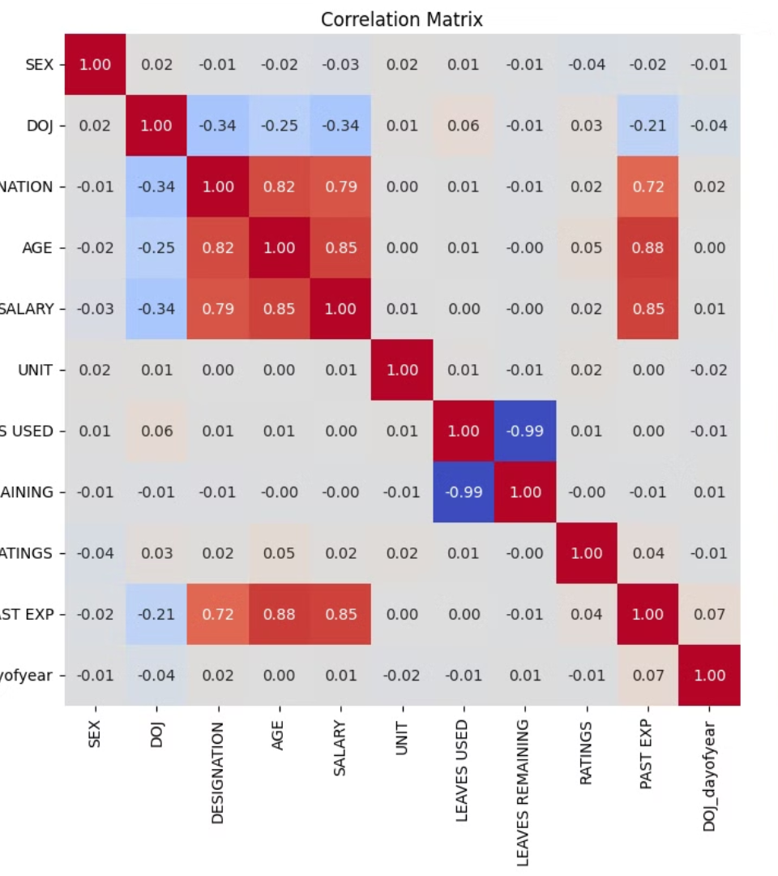
Correlation Analysis
The analysis will include a correlation matrix to quantify the strength and direction of the relationships between the various features and the target variable, salary. This will help identify the most influential variables for the salary prediction model.

Slide 6

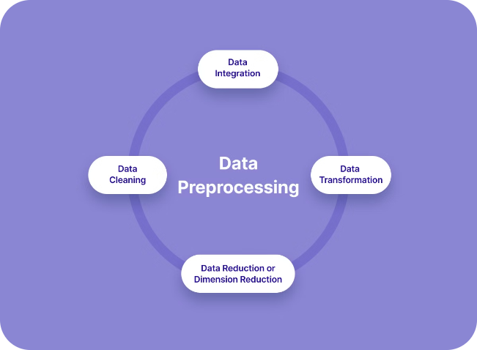
Data Preprocessing
Handling Dates
The date of joining (DOJ) feature will be converted from its original format to a year-based representation, as this is likely to be more informative for the salary prediction model.
Dropping Columns
Columns that are not expected to be directly relevant to the salary prediction, such as first name, last name, and current date, will be removed from the dataset.
Encoding Categorical Variables
The categorical features, such as sex, designation, and unit, will be encoded using binary representations to enable their inclusion in the machine learning models.

Slide 7
Model Evaluation
Model Selection
A variety of regression models, including Ridge, Lasso, ElasticNet, Decision Tree, K-Nearest Neighbors, Multi-Layer Perceptron, Random Forest, Gradient Boosting, AdaBoost, and Support Vector Regression, will be tested to determine the best-performing model for predicting salaries.
Model Optimization
The hyperparameters of the best-performing model will be tuned using techniques like grid search or random search to further improve its predictive capabilities.
1
2
3
Performance Metrics
The models will be evaluated using key performance metrics, such as Mean Squared Error (MSE) and R-squared, to assess their accuracy and ability to generalize to new, unseen data.

Slide 8



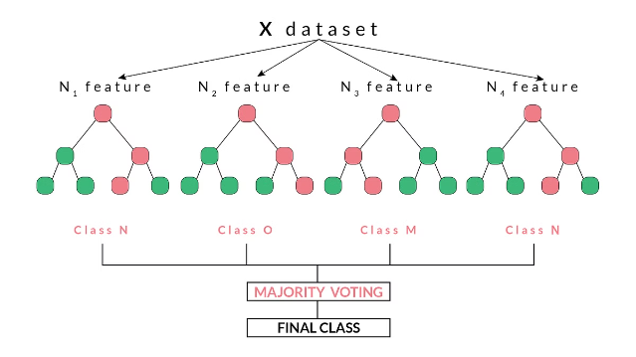
Best Performing Model
Random Forest Regressor
R-squared: 93.45%
The Random Forest Regressor model emerged as the best-performing model, with an R-squared value of 93.45%. This indicates that the model can explain 93.45% of the variance in the target variable, salary, making it a highly accurate and reliable predictor.
The high R-squared value demonstrates the model's strong predictive power and its ability to capture the key factors that influence the salaries of data professionals.

Slide 9



Implications
For Employers
For Job Seekers
The developed model can be used by employers to predict the salaries of data professionals based on their characteristics, such as age, experience, and designation. This can help employers set competitive and justified salaries, ensuring they can attract and retain top talent in the data field.
Job seekers can utilize the insights from this analysis to better understand the expected salary range for data-related roles, based on factors like their qualifications, experience, and the company's designation. This can inform their salary negotiations and career decisions.

Slide 10
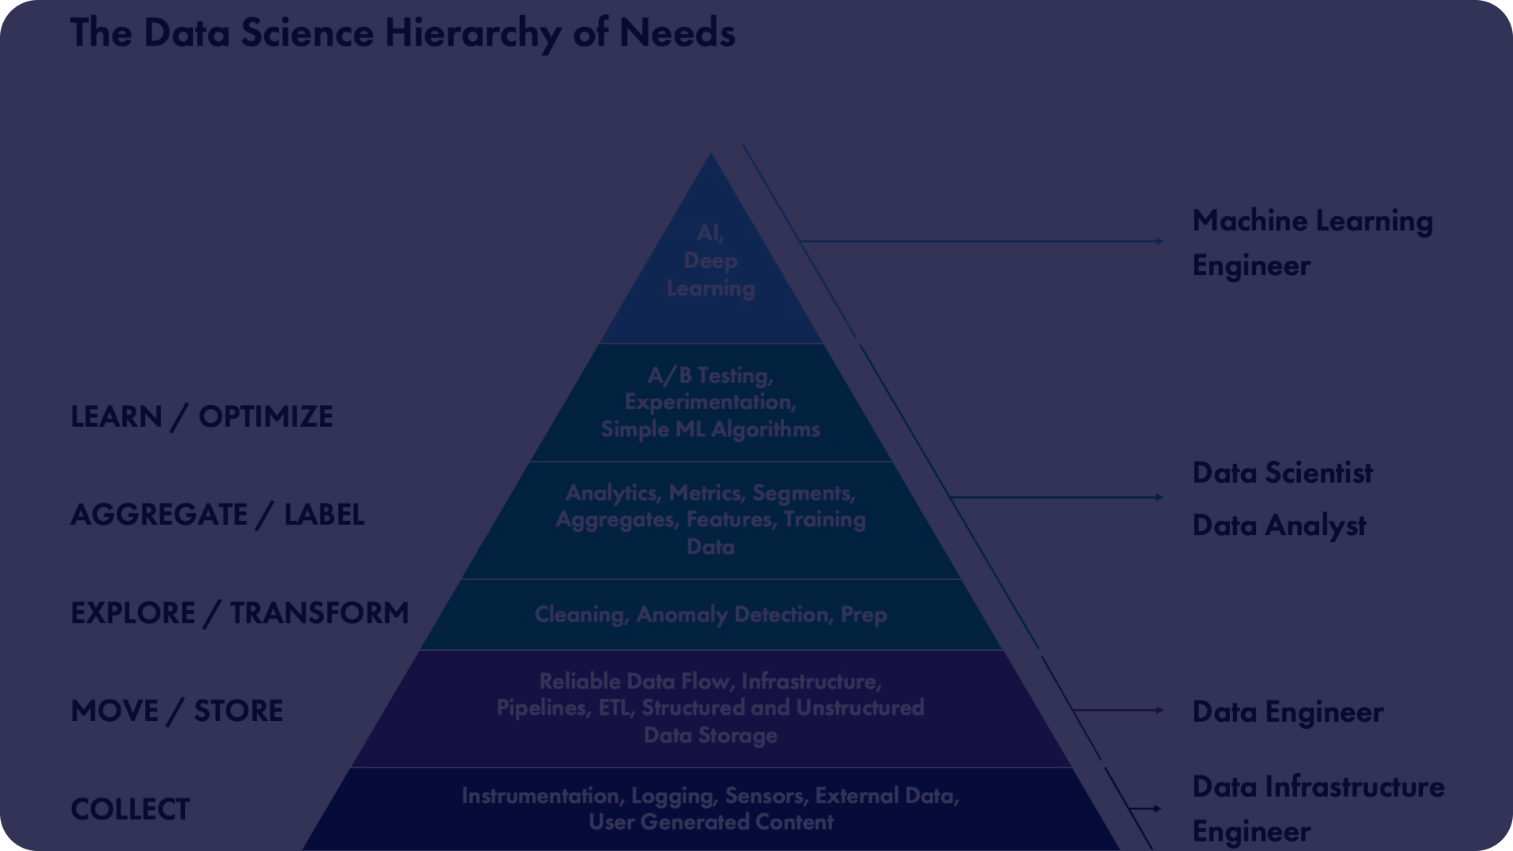
Conclusion
Key Findings
The Random Forest Regressor model achieved an impressive R-squared of 93.45%, making it the best-performing model for predicting data professional salaries.
Factors like age, experience, designation, and performance ratings were found to be the most influential in determining salaries.
The analysis uncovered potential salary differences based on gender and job roles, highlighting the need for further investigation and addressing pay disparities.
Future Directions
Expand the dataset to include more data professionals from diverse backgrounds and industries.
Investigate the root causes of any identified pay gaps and develop strategies to promote equitable compensation practices.
Explore the transferability of the model to other data-related professions, such as data analysts or data engineers.

